Slide 1

RELEX Demand Planning and Sensing for Manufacturing
Touchless forecasting for your Supply Chain Planning
June 2025

Slide 2
Challenges in Demand Planning

Slide 3







Understanding what customers will buy is critical for Manufacturing Companies
Purchase planning
Production scheduling
Production planning
Demand forecast underpins every major business decision
Key input to ensure right products are available when and where needed
Ideally the same source of truth for all planning
Demand Planning & Sensing
Fresh optimization
Integrated business
planning
Distribution planning
Inventory optimization
Replenishment & allocation
Notes:
For CPG brands, margin pressure and fleeting customer loyalty put an even sharper emphasis on the ability of the supply chain to deliver at the “moment of truth” when the product goes into a shopping cart.
In other words, to grow and expand consumer relationships that fuel profitable growth, a CPG product needs to be present on the physical or digital shelf and available for sale (or fulfillment) to meet the shopper's expectations.

Slide 4

Modest improvements in forecast accuracy deliver outsized benefits
- 2.4% order-to-deliver days
+ 0.4% perfect order performance (OTIF)
- 2.7% finished goods inventory
- 3.2% transportation costs
- 3.9% inventory obsolescence
1 pp
Improvement in
forecast accuracy
Forecast accuracy is not a business KPI – it is an input
Source: Win the business case for investment to improve forecast accuracy (Gartner, 2017)
Notes:
Source:
https://relexsolutions.sharepoint.com/sites/StrategyManagement/Analyst%20Relations/Forms/AllItems.aspx?FolderCTID=0x01200006570AFD03B56A489929251A1C89B521&id=%2Fsites%2FStrategyManagement%2FAnalyst%20Relations%2FGartner%2FGartner%20Document%20Library%2Fwin%5Fthe%5Fbusiness%5Fcase%5Ffor%5Fin%5F326350%2Epdf&q=win%20the%20business&parent=%2Fsites%2FStrategyManagement%2FAnalyst%20Relations%2FGartner%2FGartner%20Document%20Library&parentview=7

Slide 5


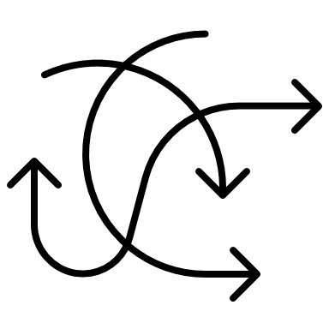






Demand Forecasting is often painful Current tools are insufficient leading to negative business impacts
Complexity
Rapidly shifting customer preferences
Seasons and promotions
Changing portfolio
Rise of DTC/Omnichannel
External factors
Processes
Heavy reliance on historical sales
Lots of manual error-prone gut based adjustments
Misaligned forecast for different planning purposes
Static algorithms that don’t learn and adapt
Consequences
Stock-outs and lost revenue
Cost of excess and obsolete stock
Suboptimal capacity plans
Reputation damage
Notes:
Using last year’s sales data as a base for forecasts is a ‘no go’, as demand fluctuations due to the pandemic skew the data. Without consistent and reliable demand data, it’s difficult to generate a baseline forecast.
There have been significant shifts in customer behaviour, making it hard to base assumptions on consumer trends. Customer behaviour continues to be erratic as buying habits reflect current events and news stories rather than actual needs.

Slide 6
Investing on forecasting technology should be high priority
Consider this mainly internal
48% of CPG companies cited Demand forecasting as their top area of focus
77% of CPG companies consider their maturity as laggard or rudimentary in Demand forecasting
Source: CGT, RIS News, 2023 retail and Consumer Goods Analytics Study
Demand is not just something that can be predicted; it is increasingly known, based on the data, integrations, technology, and ability to mine this information.”
Tom Madrecki,
VP of supply chain and logistics at Consumer Brands Association
Notes:
https://consumergoods.com/ris-cgt-analytics-study-2023?email-confirmed=1736025386732

Slide 7
How RELEX could transform your Demand Planning

Slide 8

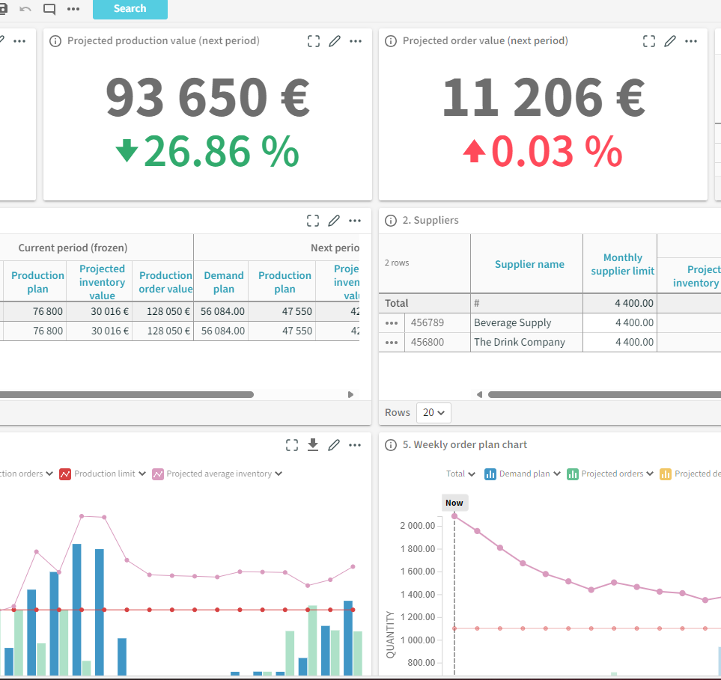
Transforming the process from manual to touchless forecasting
Manual
Touchless
Heavy reliance on historical sales
Lots of manual error-prone gut based adjustments
Misaligned forecast for different purposes
Static algorithms that don’t learn and adapt
Multiple inputs automatically combined
AI in the center, human to control and resolve exceptions
One source of truth for all planning
Dynamic updates based on continous learning
Notes:
Static information
Multiple information sources to parse from
Human in the center

Slide 9


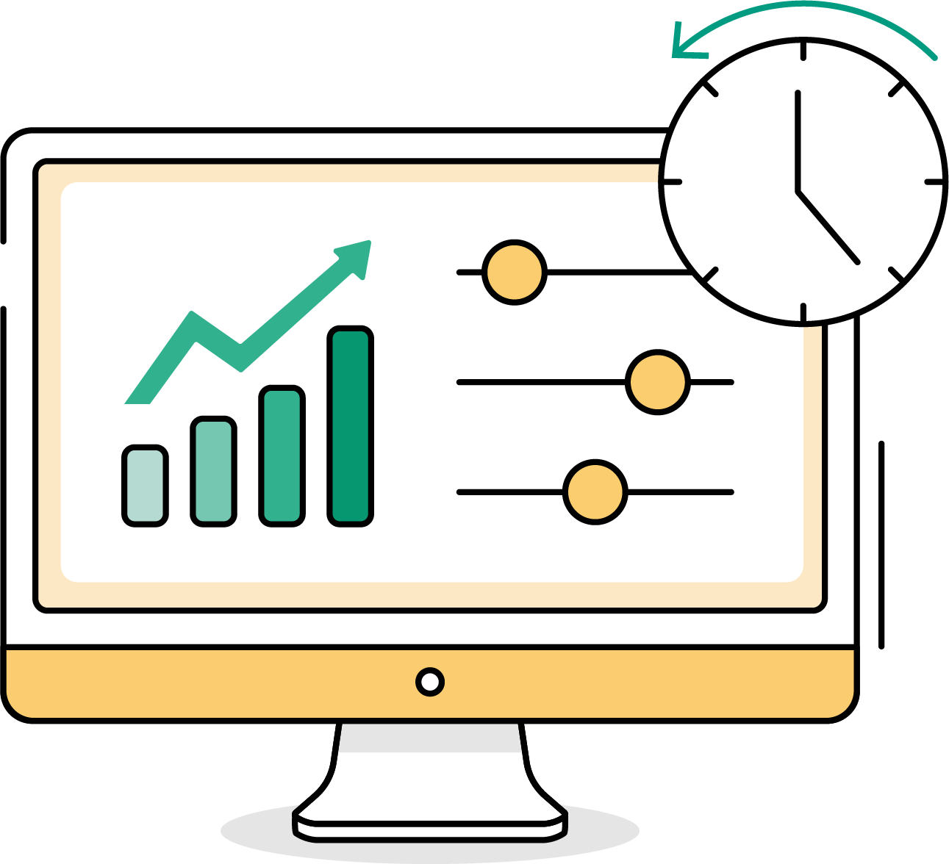



RELEX is the right partner for touchless forecasting AI driven technology building one source of truth for all planning
Dynamically resolve the forecasting complexity with AI
Streamline planning processes
Demand patterns
Internal
factors
Tailored dashboards
Alerts on exceptions
Scenario planning
Ease of collaboration
ML Forecasting
with Demand Sensing
External
factors
With RELEX, planners spend much less time on demand planning – 98% of the forecasts are untouched for several products
- Maag Foods

Slide 10


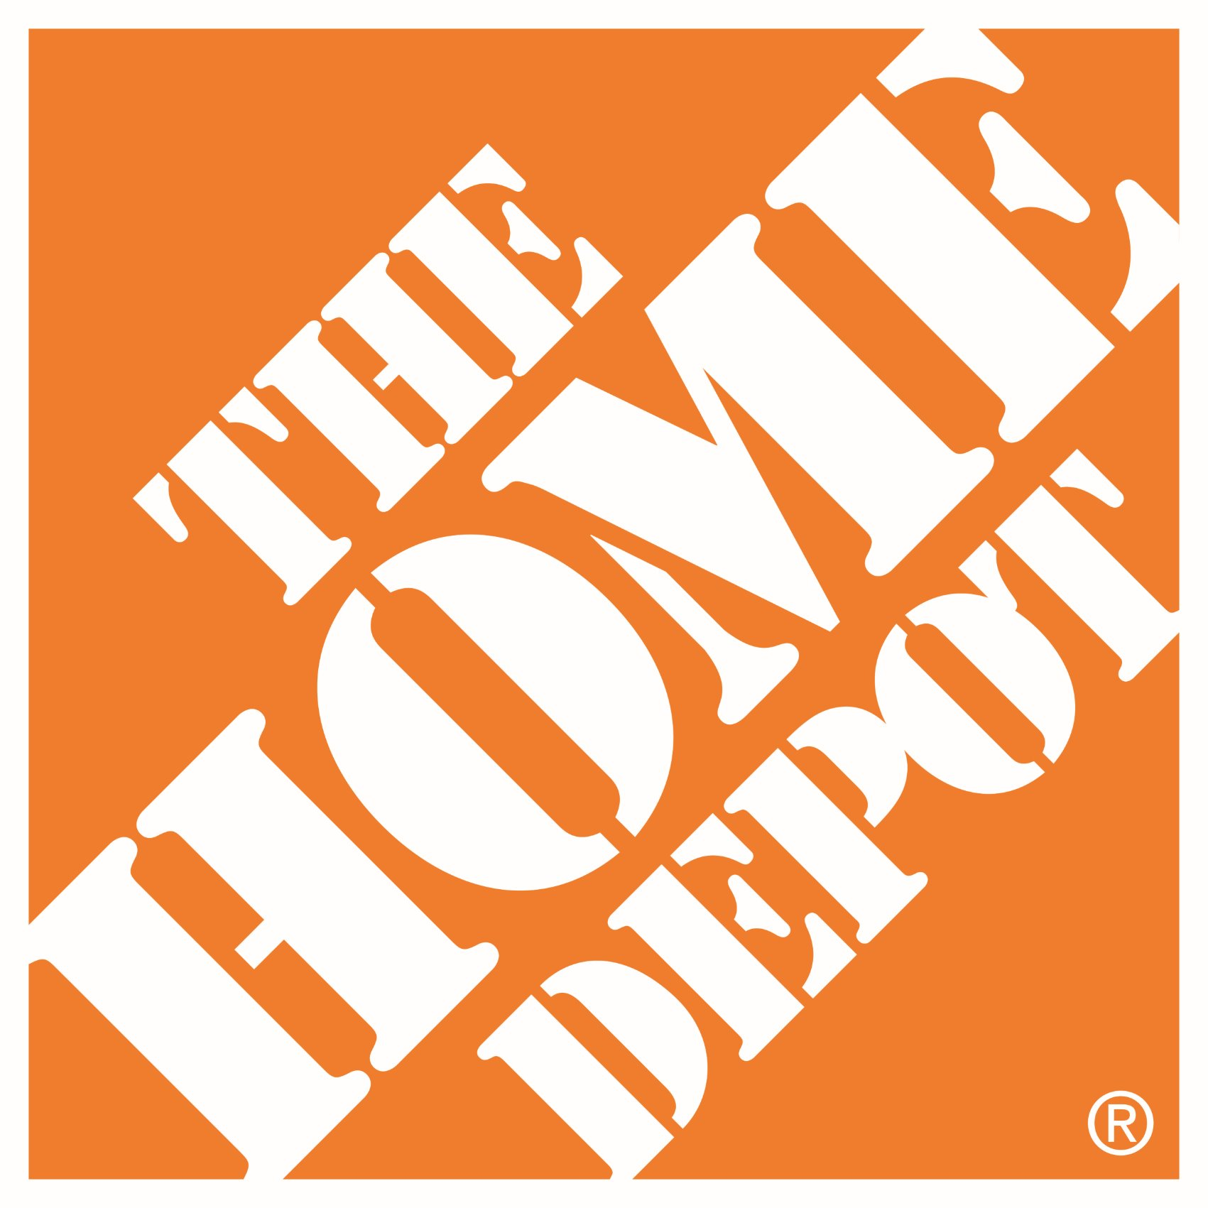


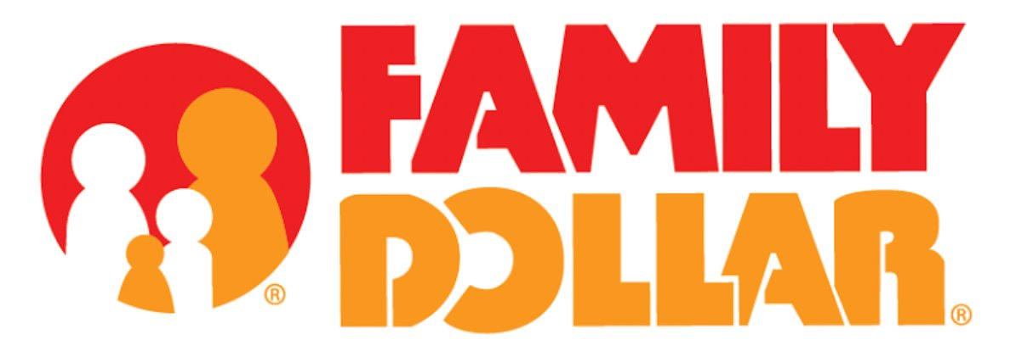


Proven by customers
150+
customers using RELEX ML forecasting including the world largest retailers
All implementations since 2021 based on AI / Machine Learning
98.1%
Forecast accuracy on the weekly level, leveraging retail data
Up to 98%
Forecasts are untouched
Notes:
Following the introduction of machine learning, we were extraordinarily impressed to see just how much further RELEX’s algorithms could improve our forecast accuracy and stability.”

Slide 11


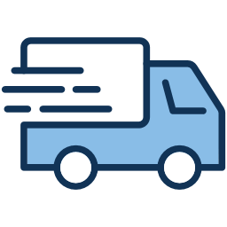


Demand Planning and Sensing is a seamless part of RELEX Supply Chain Planning
Supply
Demand
Raw materials
Manufacturing
Distribution
Retail Distribution
Retail channels
Consumers
Raw materials order plan
Forecasted demand & orders
Forecasted demand & orders
Demand forecast
Fulfilment
Demand
Materials delivery plan
Production plan
Distribution & allocation plan
Replenishment
Production Scheduling
RELEX solutions
Master planning
Purchase Planning
Production Planning
Distribution Planning
Demand Planning and Sensing
Inventory Planning
Integrated Business Planning
11
Notes:
•Disconnected planning across different teams, systems and geos creating decision latency
•Slow planning cycles and misaligned planning levels, and planning parameters that do not represent the reality create plans that are not feasible for execution
•Siloed targets and decision-making leading to sub-optimization
•Lower service levels and unnecessary cost and spoilage across the supply chain
Suppliers
Supply delays and shortages
supplier risk
deal buys
alternative suppliers
Manufacturing
Set-up times
Allergens
Alternative recipes
Stock build
Shelf life
Production capacity constraints
material shortages
production delays
budget constrain
Distribution
Supply delays
Shortages
Storage capacity
Retail Distribution
Inventory availability
lead times
promotions
Retail Channels
Commercial decisions
new channels
targets
customer priorities
Consumers
Demand shifts
consumer preferences
changes in promotional impact

Slide 12
Why Machine Learning
The RELEX standard in forecasting for years
Notes:
We know this as we did a major migration and used multiple years of development to move from TS forecasting to full ML forecasting.

Slide 13
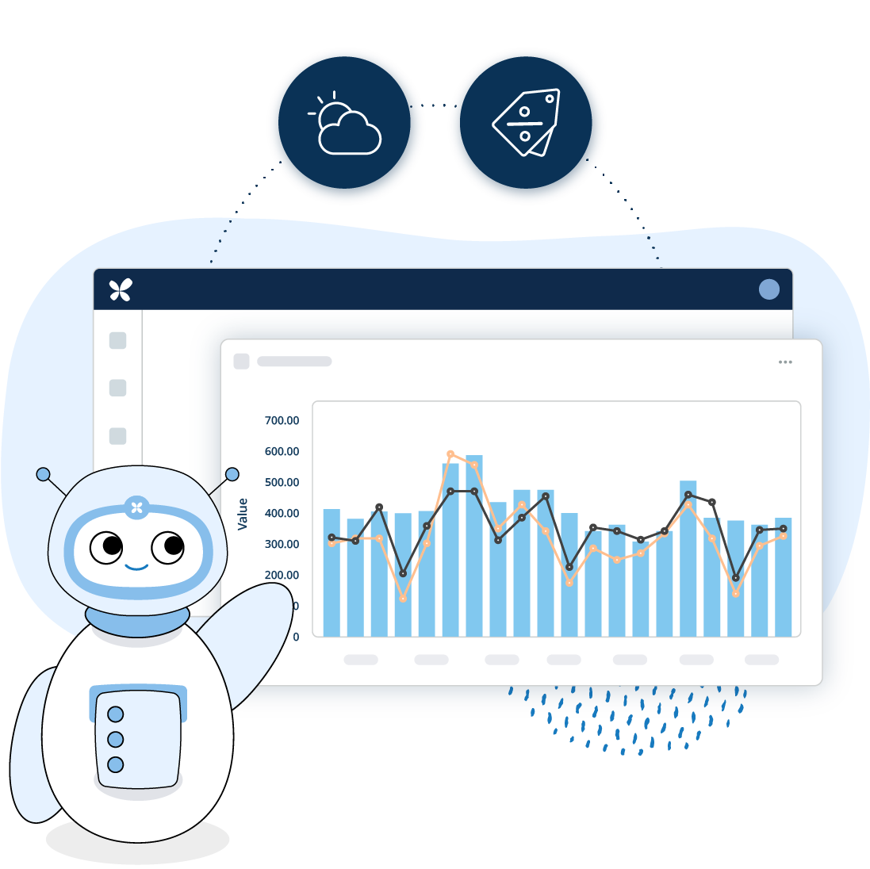
Why is Machine Learning better than Time Series
Better forecast accuracy, especially when demand is impacted by
Overlapping promotions
Weather changes
Cannibalization and halo
Operational benefits
High automation with less configuration
Adaptability to leverage new data inputs in the models
Self-contained improvement through continuous learning
Reacts faster to changes and with more confidence
Ability to use POS and other external data for Demand Sensing
Notes:
So why machine learning?
First, Machine learning is able to react to the changes much faster than traditional methods due to its ability to explain changes in demand with data.
Second, Machine learnings ability to understand complex relationships between different demand influencing factors means that it’s especially good in situations like:
Overlapping promotions
Weather changes
Products with cannibalization or halo effects
Third, Machine Learning also provides operational benefits due to:
Higher automation with less manual work
More adaptability to leverage new data inputs
Models continuously learn and adjust based on new observations
Link this to the current challenges which are impacting the demand fluctuation. Now inflation has been a big driver for changing demand patterns.

Slide 14
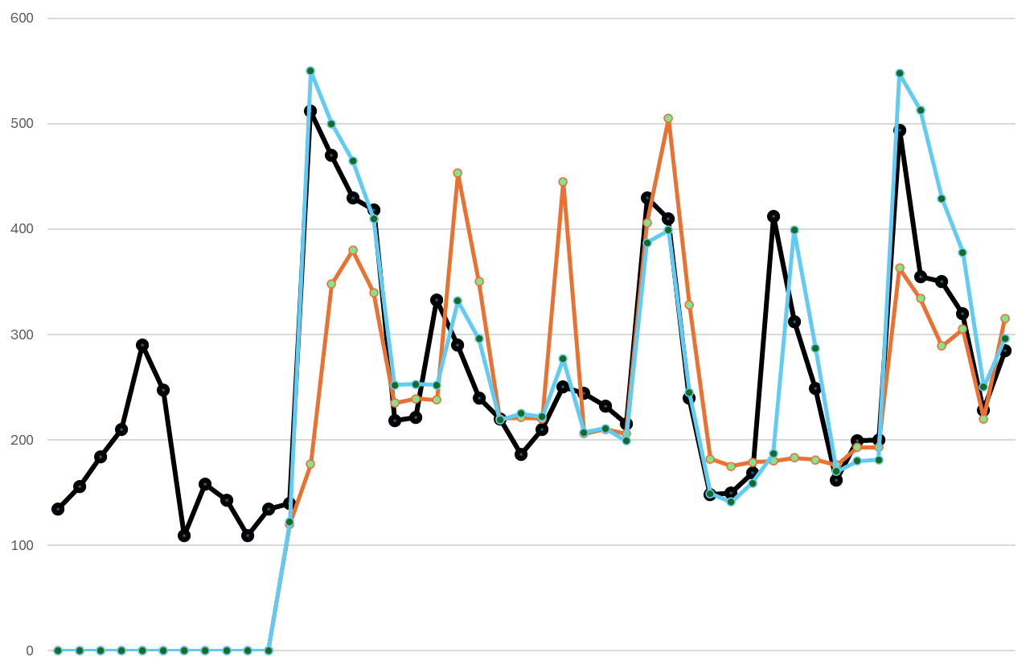
Leading to better results in any circumstance Our experience from our product journey and customers
Sales ML Forecast TS Forecast
10% discount – high impact
10-20%
less need for manual changes
2-5 pp
improvement in forecast accuracy
1.5 pp
improvement in availability
5% discount – low/no impact
The example above shows that ML forecast better captures the price impact than Time Series (TS) forecast
Notes:
We rebuilt our forecasting engine to be ML based a few years ago

Slide 15
RELEX Demand Planning and Sensing
Building one truth of demand across all products and time horizons as a basis for planning

Slide 16
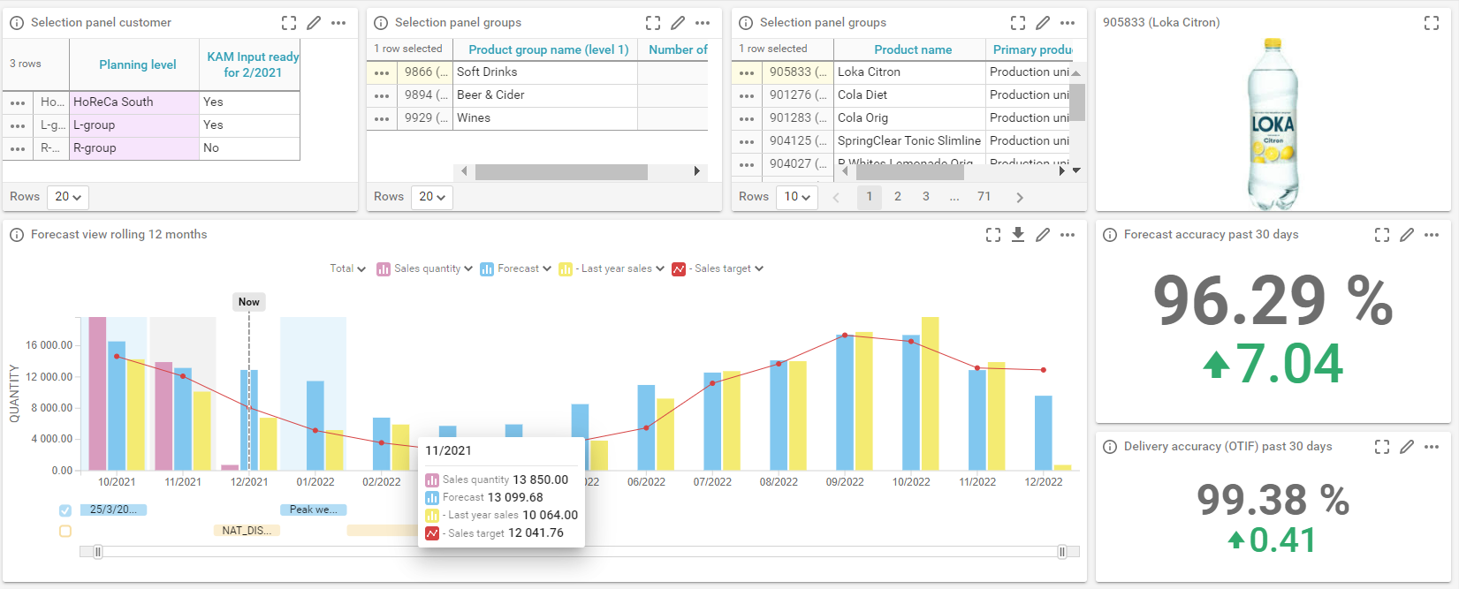
Demand Planning and Sensing Powerful and agile AI-driven forecasting that meets the most demanding forecasting challenges
Benefits
100% ML based with flexibility to use any demand influencing factor
Granularity at SKU/day level with aggregation to higher levels
Exception based management and easy forecast adjustments for efficiency
Seamless collaboration with downstream partners
Seasonality and events
Promotions
New product intros and product terminations
Notes:
Demand forecasting and collaboration
*Requires Add-on modules:
Demand sensing (Ability to use POS, weather and cannibalization data)
Kitting
Promotions

Slide 17
Ability to leverage all demand drivers
Demand patterns
Seasonality, trends, weekday-related variation
Business decisions
Forecast as a key component of demand planning
Promotions, assortment changes, new product introductions
RELEX
Machine Learning Forecasting
External factors
Demand Sensing
inputs
Holidays, footfall, local events, competitor activities, product rating
Point of Sale data
From downstream retailers
Demand Sensing is not a separate layer, but just additonal inputs to the same forecasting model
Notes:
RELEX can model any demand impacting factor and use it in forecasting

Slide 18
Single source of truth for all planning Providing the right level and granularity for each use case
Day and SKU level
Week and product level
Month and product group level
Demand
forecast
2-4 weeks
3-6 months
24+ months
Inventory allocations and replenishment
Distribution requirements planning (DRP)
Production planning and scheduling
Promotion planning
Master production schedule
Material purchase planning
Assortment planning
Rough-cut capacity planning
Product and market planning
Financial planning
Notes:
To effectively execute replenishment, capacity planning, and other business decisions, retailers and CPG companies need multiple forecasts with different levels of granularity that look at different time spans. This is why flexible aggregation across products or over different planning horizons is critical to a company’s ability to leverage the same demand forecast in all their supply chain planning.

Slide 19
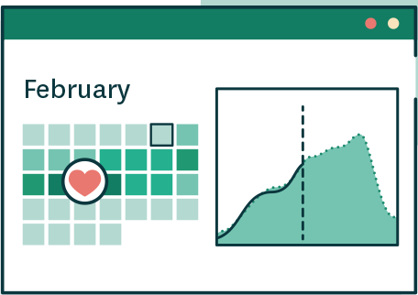
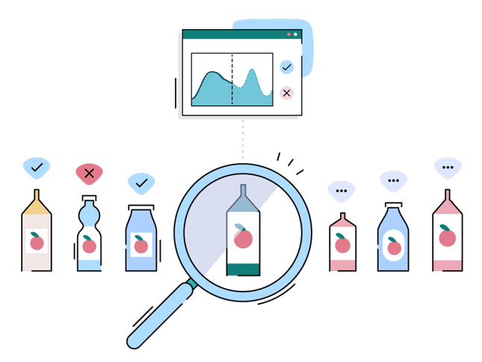
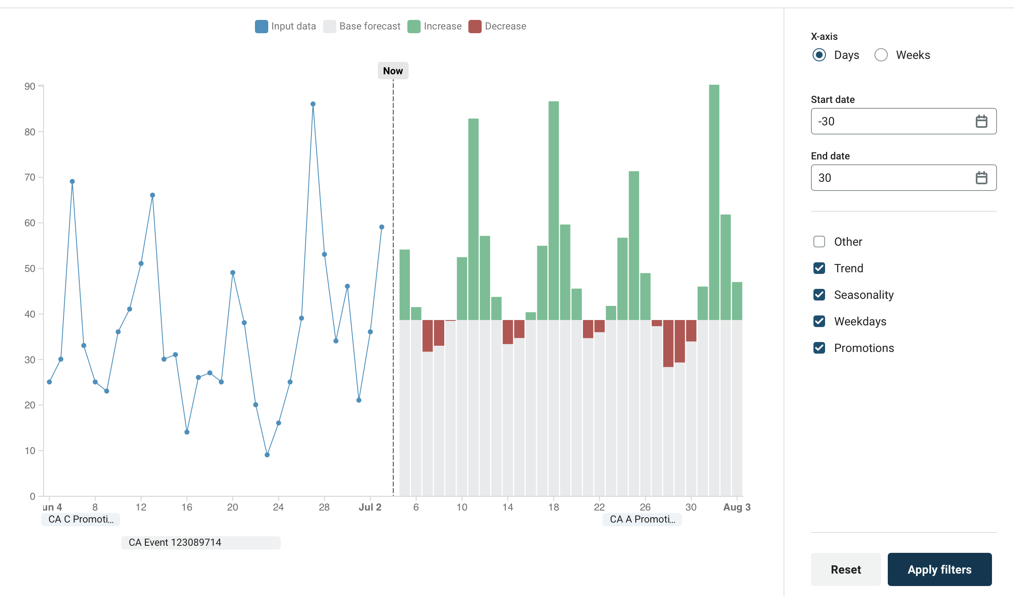
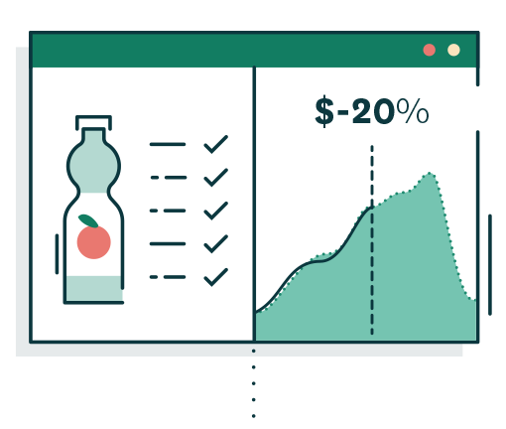
Forecasting promotional impact on demand
Benefits
Manage and maintain promotion master data and calendar
High forecasting accuracy with automated promotion forecasts
Separation of different promotion types e.g. price discounts and bulk discounts
Streamlines demand planning and demand shaping process
Optimized supply chain operations such as replenishment, distribution, purchasing and production
Ability to analyze promotion impacts both on retail POS (sell-out) and on customer orders (sell-in)
What-if analysis of adding a new promotion
Leverage ML to forecast promo lifts and profiles for each promo type
Detect cannibalization relationships and model both cannibalization and halo in forecasting*
Continuously analyze promotional performance during and after
Notes:
Automatic calculation of demand forecast with anticipated promotional impacts based on detailed data.
Transparent process in RELEX User Interface
Managing and maintaining promotion master data and calendar
What-if analysis of impact on forecast if adding a new promotion
Copying past campaigns into the future as preliminary placeholders to better account promotional impact in long-term forecast
Allows an unlimited number of campaign types (price, display, marketing), just need to make sure there is enough history to calculate the forecasts on
Possibility to review and edit promotion forecasts in a dashboard
Monitor performance during promotion and analyze performance after
If PoS-data is available, this can include comparing point-of-sale with sell-in to identify customers' pipeline fill and forward buy effects on demand
Calculation of campaign profiles - coming in Q2/2024
Helps providing more accurate forecast for campaigns where sales is typically unevenly distributed over the campaign period
4. *Cannibalization and halo are part of Demand Sensing module (add-on in RELEX Demand Planning)

Slide 20
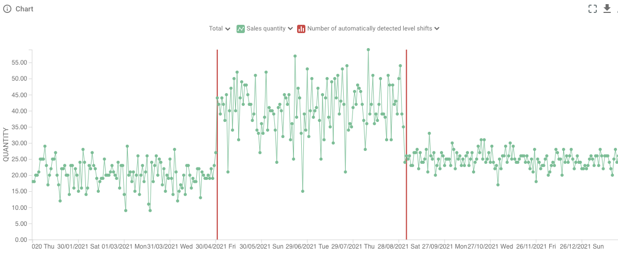
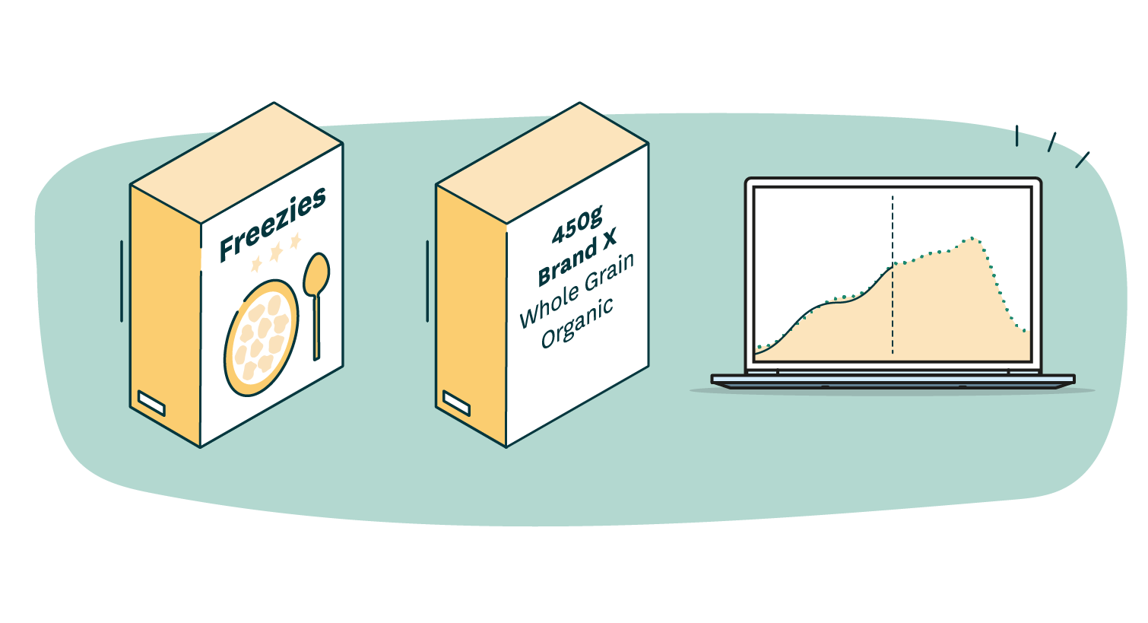
Overcoming the typical forecasting challenges
Data quality
Scarce data
Use of pooled models with slow-moving, highly seasonal products
Automatically leverage of pooled data to model effects that are hard to see from one product-location
…when demand fluctuations are unexplainable…
RELEX can automatically detect level shifts and adapt that into the forecast model
New products
Automated reference product assignments in new product introductions
New item
needing a forecast
Attributes and references
Initial reference-
based Forecast
Notes:
Ensuring data quality
There’s plenty of data in retail, but on detailed level (SKU-store) it is often scarce, messy and contains missing information, not all changes in demand can be explained in advance
Step change detection in demand with no explaining data:Level shift detection finds statistically significant points in time where the level of demand has changed without any known explaining factor, ML model consumes the detected level shifts and improves the fit and estimate of demand influencing factors like promotional discount
Automated outlier corrections as part of data cleansing: Outlier detection is a basic tool in many data science applications. RELEX Outlier detection is specially designed for consumer goods supply chain data, for example by natively understanding seasonality, trends and other local variations
Use of pooled models with slow-moving, highly seasonal products
Automated reference product assignments in new product introductions

Slide 21
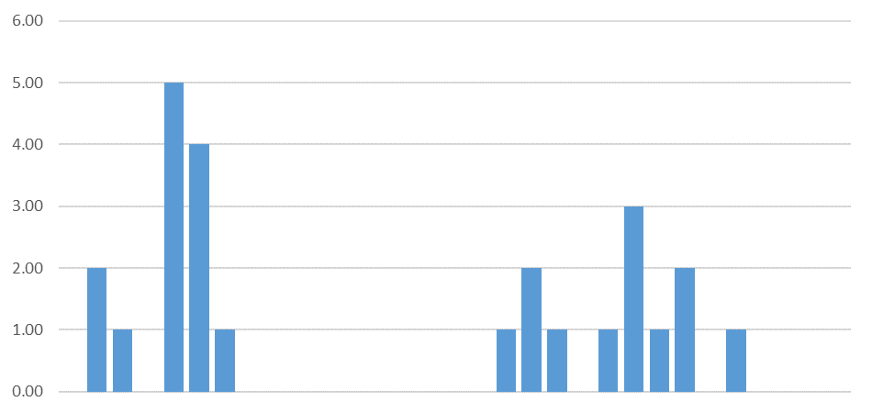
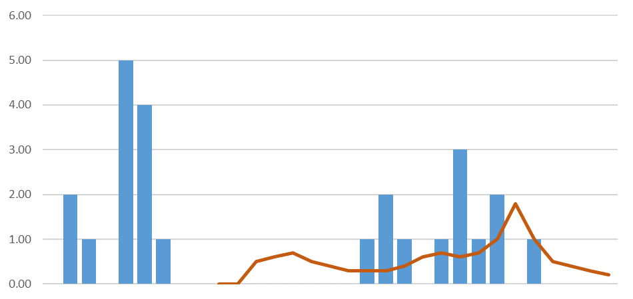

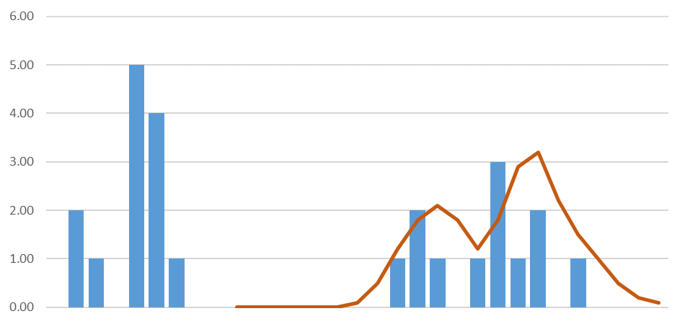

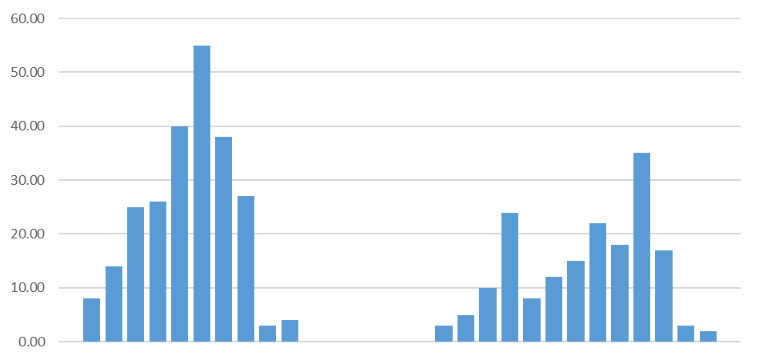
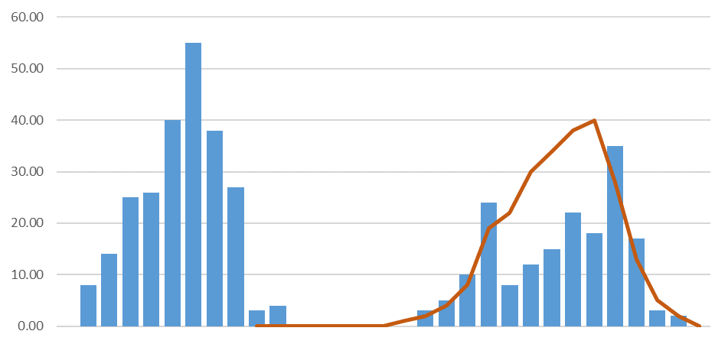
Pooled models in RELEX ML forecasting Accurate forecasts with slow moving and seasonal products
Single (seasonal) product–location with scarce data
Product–location
forecast
Sales quantity
Improved product–location forecast based on pooled data
Seasonal product with pooled data
Forecast based on pooled data
Sales quantity
Location-specific information utilized
Notes:
Use of pooled models with slow-moving, highly seasonal products
Share information between product-locations
When estimating a model for slow-movers, the model ’sees’ more data, making it possible to estimate effects like seasonality and trend
Model effects on multiple levels to balance between pool level information and product-location level information
Some effects, like baseline is modelled on product-location level for accuracy
Other effects, like trend and season are modelled on pool level for robustness
The decision is automatic and doesn’t require user intervention

Slide 22
Demand Forecasting process in RELEX
Data preprocessing
01
The forecasting engine preprocesses and cleans the data, works around the gaps in provided data and detects outliers.
One modelling approach that incorporates all demand influencing factors
High automation with very little manual work with users focusing on exceptions, enriching data and making judgement calls on the future
Model estimation
Forecast calculation
Data preprocessing
Model estimation
02
Continuous
learning from
sales and transactions history
The forecasting engine automatically learns relationships between demand and various influencing factors
Calculate forecast
03
Accurate day level demand forecasts are calculated

Slide 23
Enhancing visibility and accuracy using Demand Sensing inputs

Slide 24
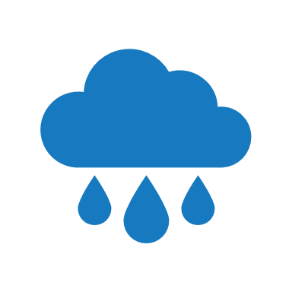

Use of additional data for Demand Sensing Getting a more accurate and timely view of true end-user demand
Sell-in
Sell-out (POS)
Manufacturer
Retailer
Consumers
Use of Retail POS if available
Sell-in data is the standard used by CPG companies
Selling signals get heavily distorted and delayed when moving upstream
Visibility to sell-out (POS) data gives CPG companies real pulse on the consumer behaviour
Especially useful in promotions, assortment changes and new product introductions
Use of external data e.g. weather
Weather has an impact to demand changes of certain products
For those products weather forecast can be used to improve forecast accuracy - especially in short term

Slide 25
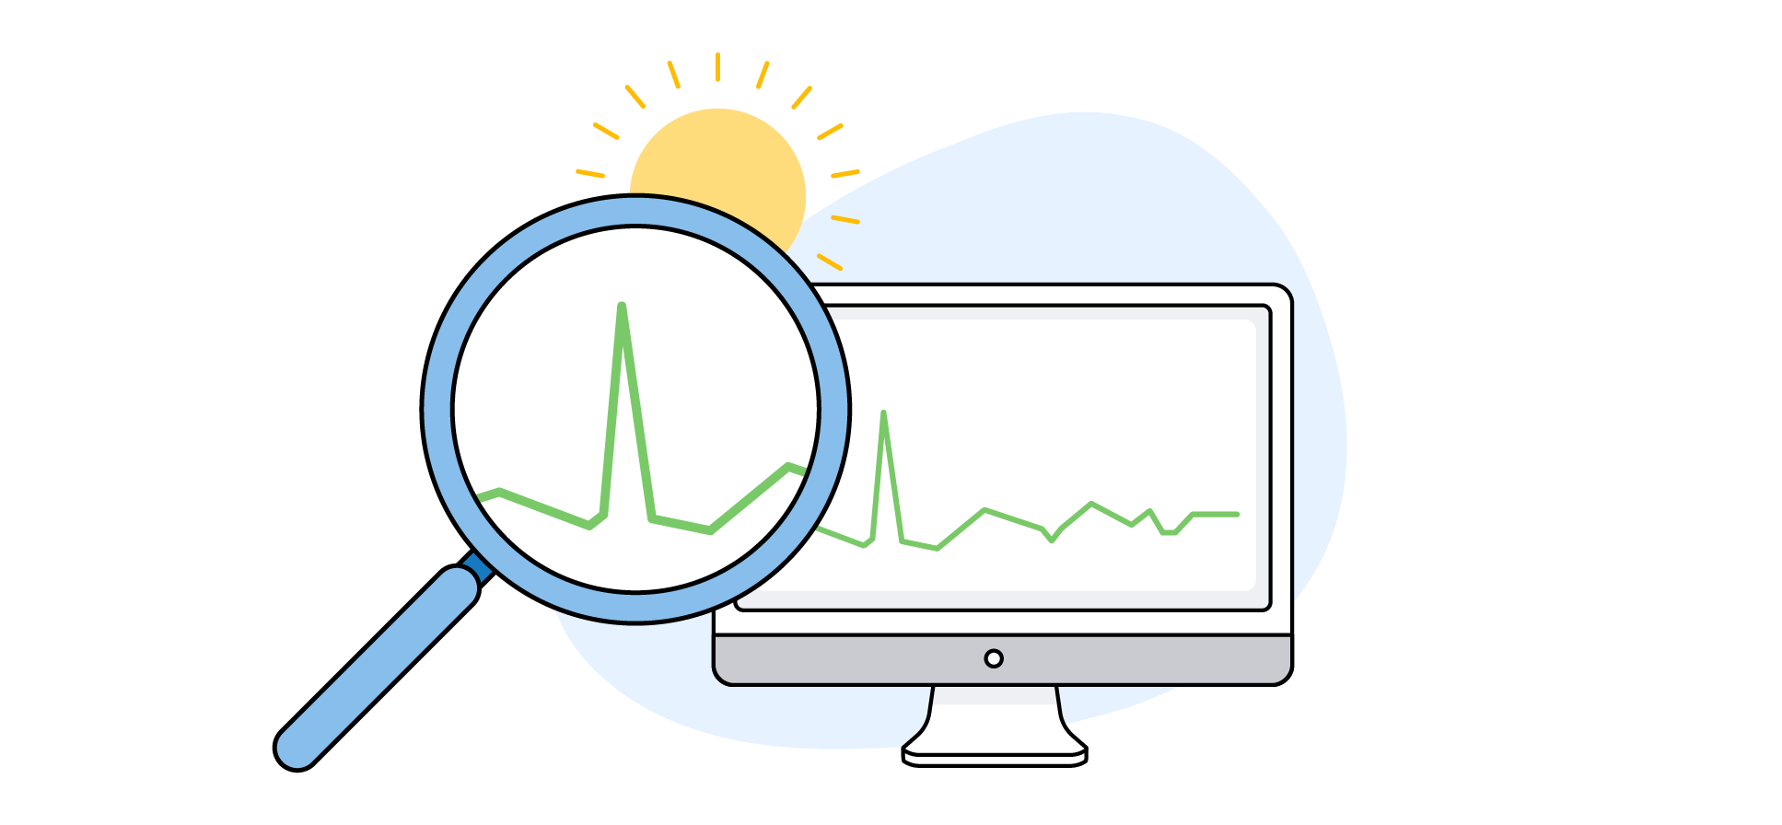
Demand Sensing signals in RELEX Make forecast more responsive to changes by including additional demand signals
Benefits
Elevate service levels and improve inventory turnover of products, whose demand is significantly influenced by multiple variables
Process streams of current external data instead of historical shipment data
View demand changes as they happen and adapt quickly
Increase demand planning process efficiency
Demand sensing
Additional signals
Retail POS data
Weather data*
RELEX ML
Forecasting
Possibility to add other demand signals
*RELEX has an integration with weather data API
Notes:
Consideration of point-of-sale (POS / TLOG)-data. Read in POS- sales from retailers and provide visibility and potentially incorporate with demand forecast (ability to learn which products are bought together, intraday patterns, customer buying behaviour)
Weather data integration and incorporating into forecast. Automated calculation of forecasted weather impacts on short-term direct consumer demand for weather-sensitive products. (RELEX has integration with Meteomatics API for weather forecast data.)
Automated promotional cannibalization detection* and modeling into forecast. Decrease spoilage of products, whose demand is decreased when cannibalizing product is in campaign
User-defined promotional halo relationships* and modeling into forecast. Increase sales and availability of products, whose demand increases when a haloing product is in campaign

Slide 26



Experience from different regressors for demand sensing Examples of RELEX customers
Traveller footfall
International Convenience store chain at the airports
Retail POS data
Multiple Tier 1 CPG&Mfg companies
Weather data
Multiple retail and CPG companies in FMCG
Hurricane event forecasts
Top 10 retailer globally
RELEX can model any demand impacting factor and use it in forecasting
Notes:
Traveller footfall -> WHSmith case (UK)
Weather -> Over 15 retail customers, Samworth Brothers
POS -> Atria, Samworth soon
Hurricane -> Home Depot

Slide 27
Driving efficiency in planning
Touchless forecasting: Highly automated, but not a black box

Slide 28

Advanced capabilties enabling efficient planning processes Combining AI-driven automation and human expertise
Automation
Human expertise
Exception
management
Consensus
planning
Processes
Continuously calculated forecasts
Demand Planner
What-if analysis
Sales and Account Managers
Process
adaptations
Superuser
Enablers
AI*
Best practices
Intuitive
Dashboards
Scenarios
Business Rules Engine
* Specialized AI (e.g. ML) and GenAI
Notes:
Processes / use cases listed from daily operations (execptions) to less frequent ones (configuration changes)

Slide 29
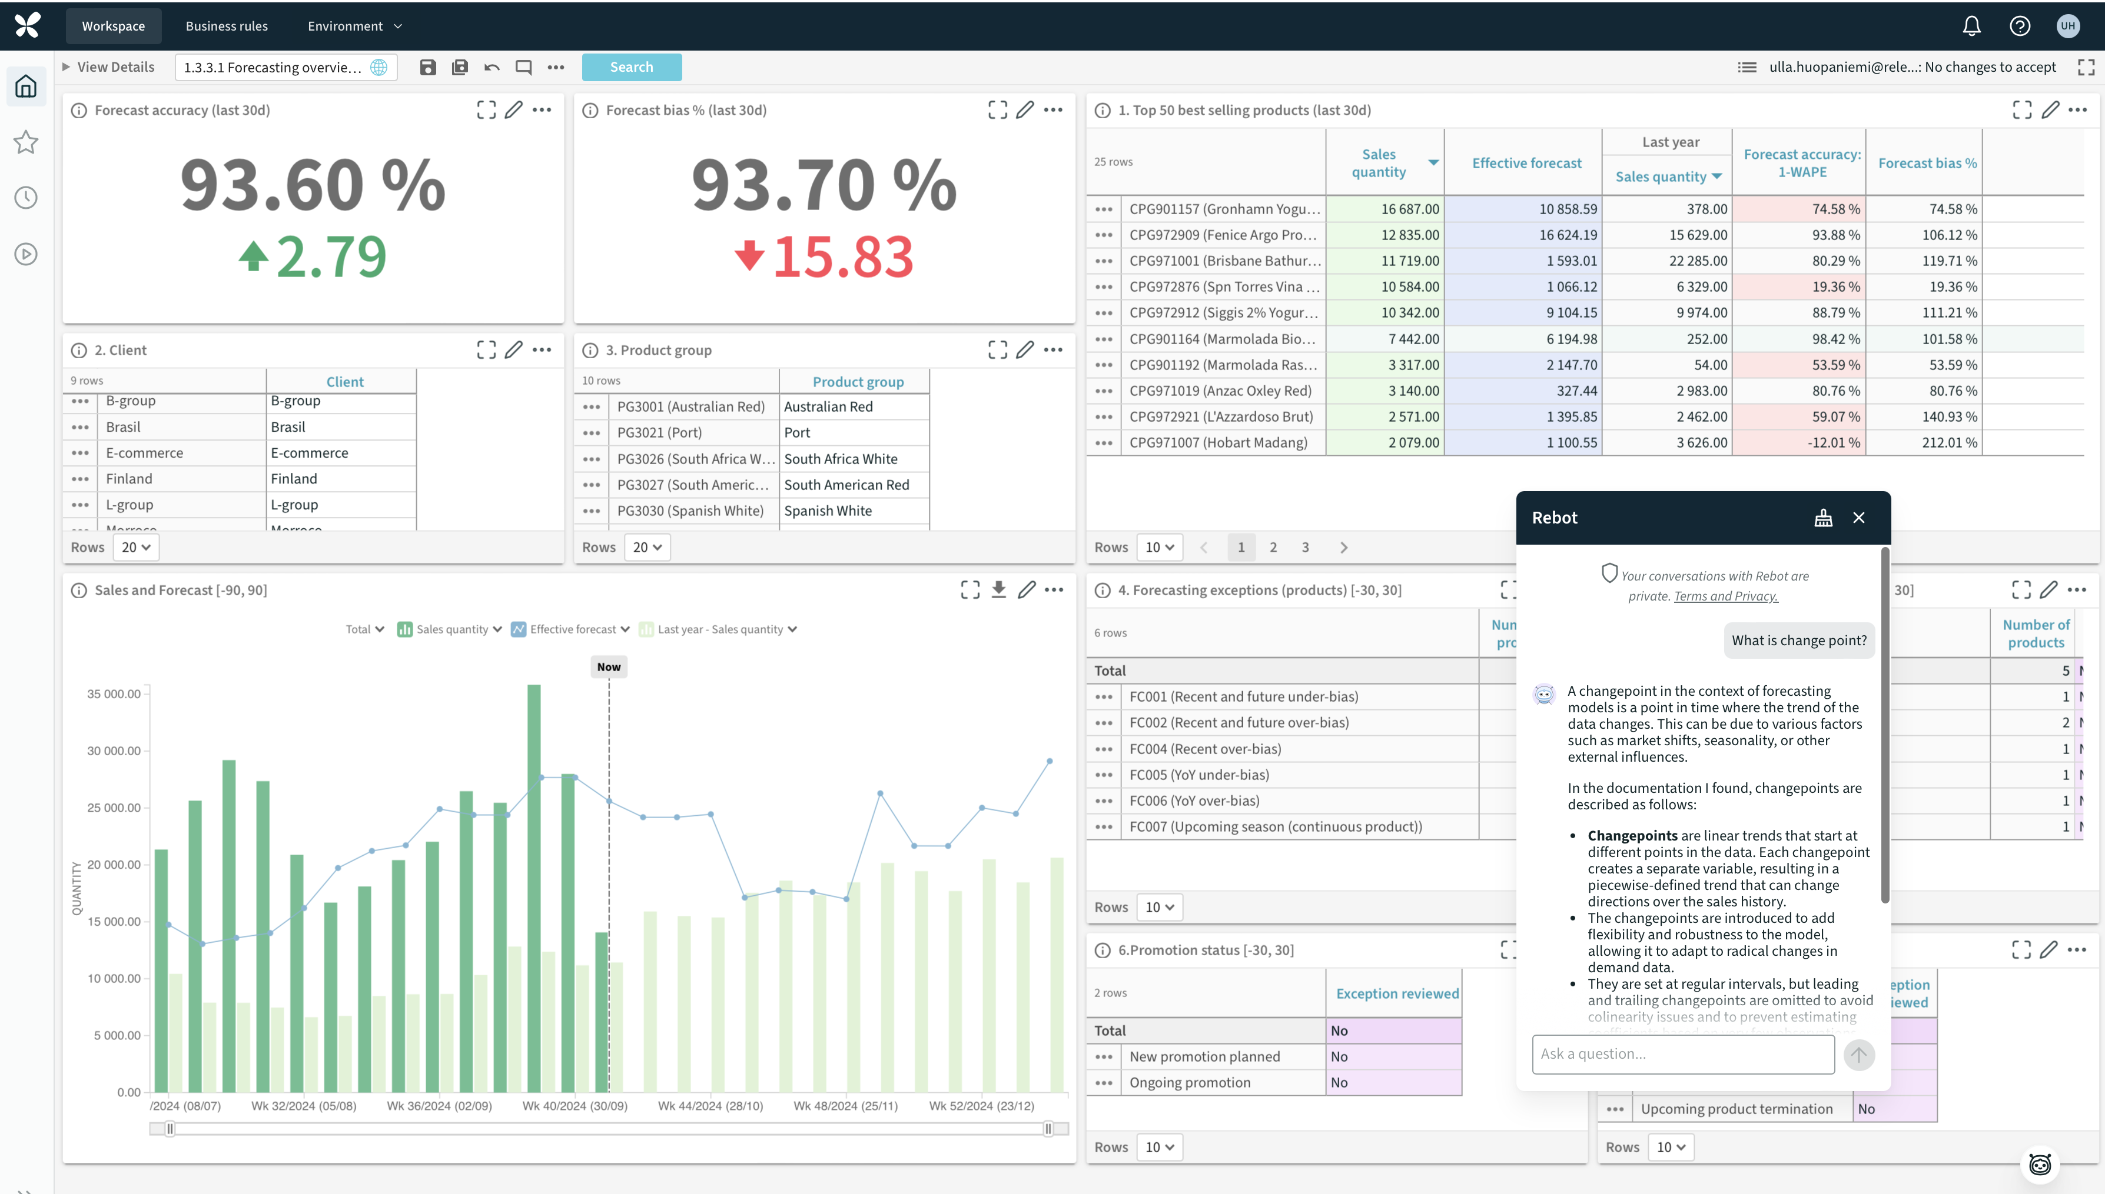
Intuitive dashboards with exception based management
AI
Best practices
Visibility to forecasting performance
Intuitive
Dashboards
Exceptions user should focus on
Filtering of view based on selections
GenAI assistant, Rebot

Slide 30
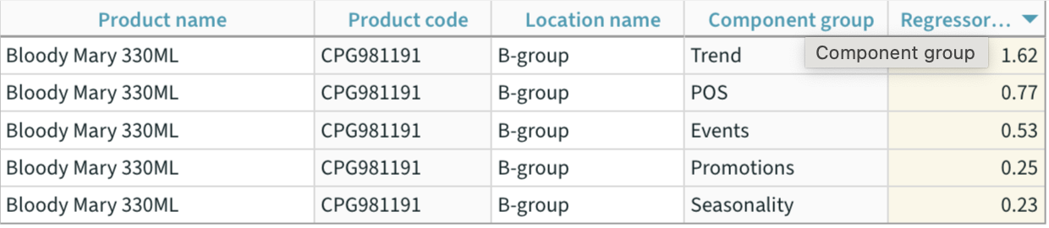
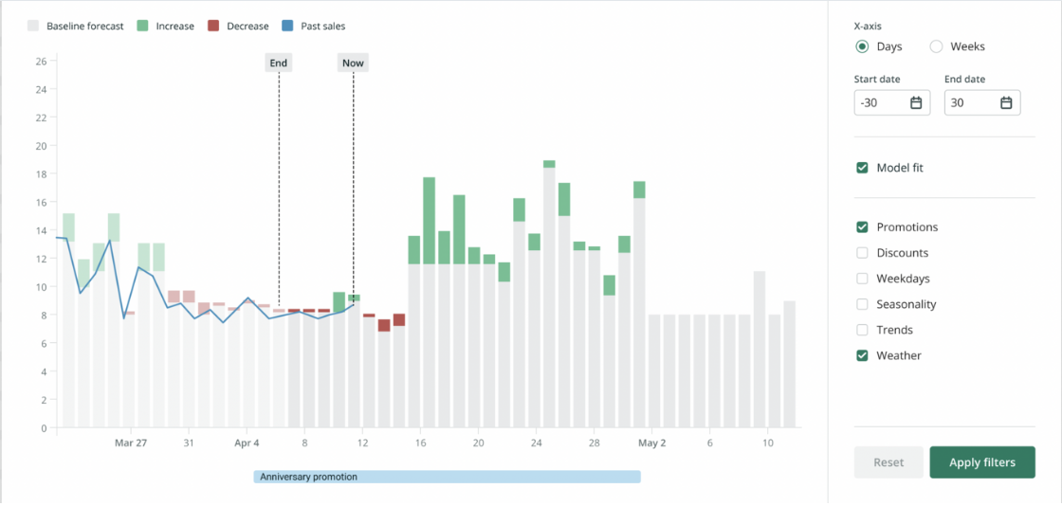
Forecast visualization providing transparency to forecast Ability to see the forecast components and their impact to baseline
Intuitive Dashboards
See how the forecast model fits into the history and actual sales
Show the impact of each regressor to the forcetast
Filter and see the impact of one or multiple factors to the baseline
Important visibility e.g. in exception management and resolving issues
Notes:
Not a black box

Slide 31
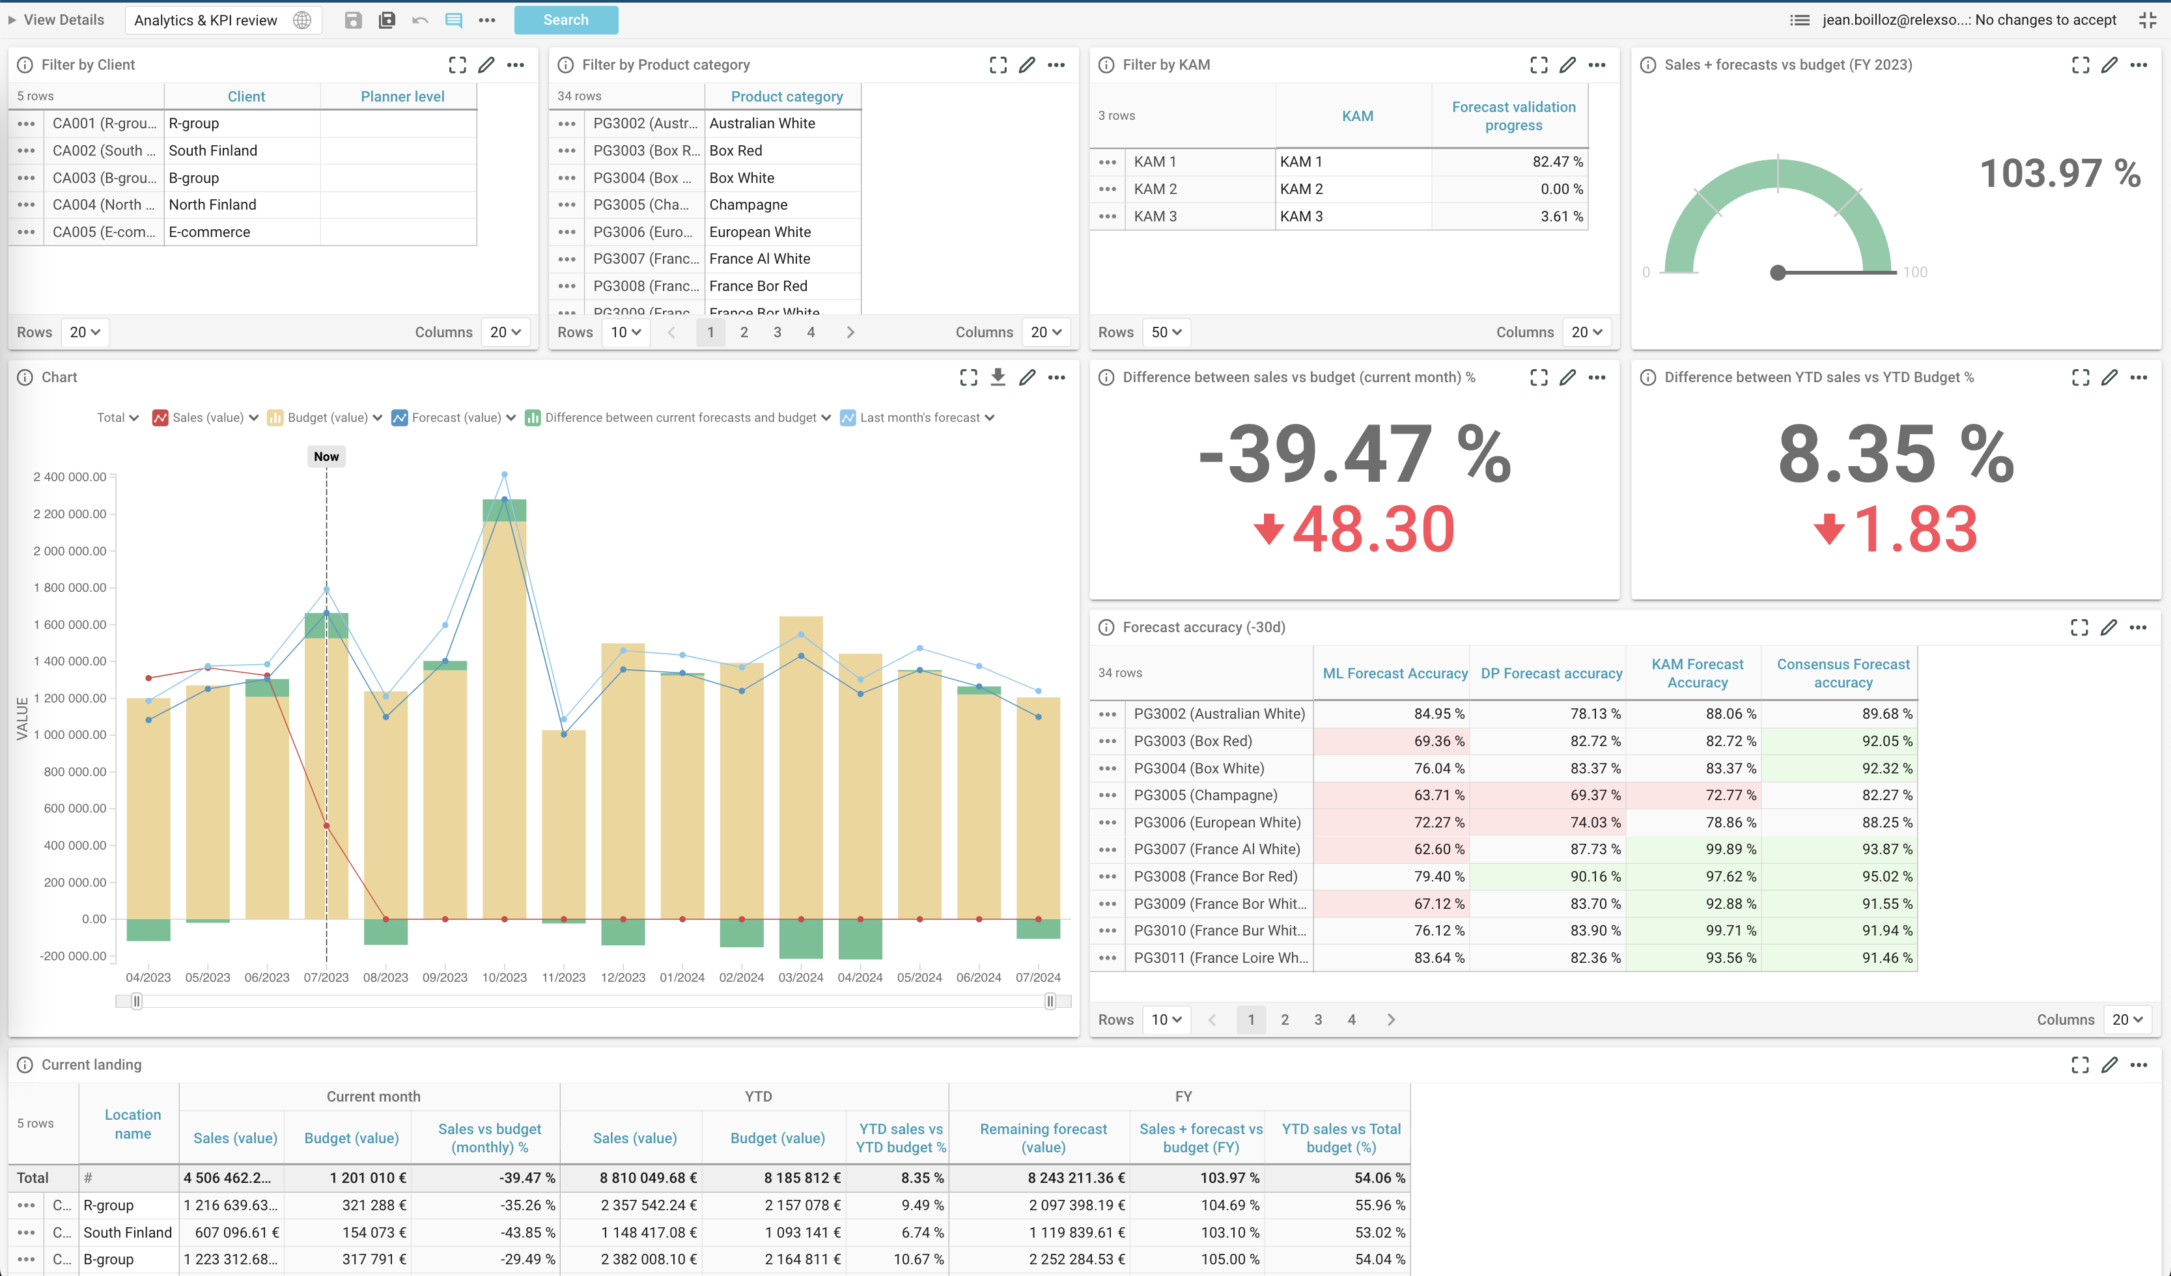
Consensus planning between teams Same data and plan with different roles and views
Intuitive Dashboards
Monitor the progress of the process
Key Account Managers (KAM)
Ability to view and provide inputs to specific customers forecasts calculated by RELEX
Sales Manager
Ability to see calculated and KAM inputs and build a consensus
Forecast accuracy comparison
Sales performance
Dashboards, user rights and workflows easily adjustable

Slide 32
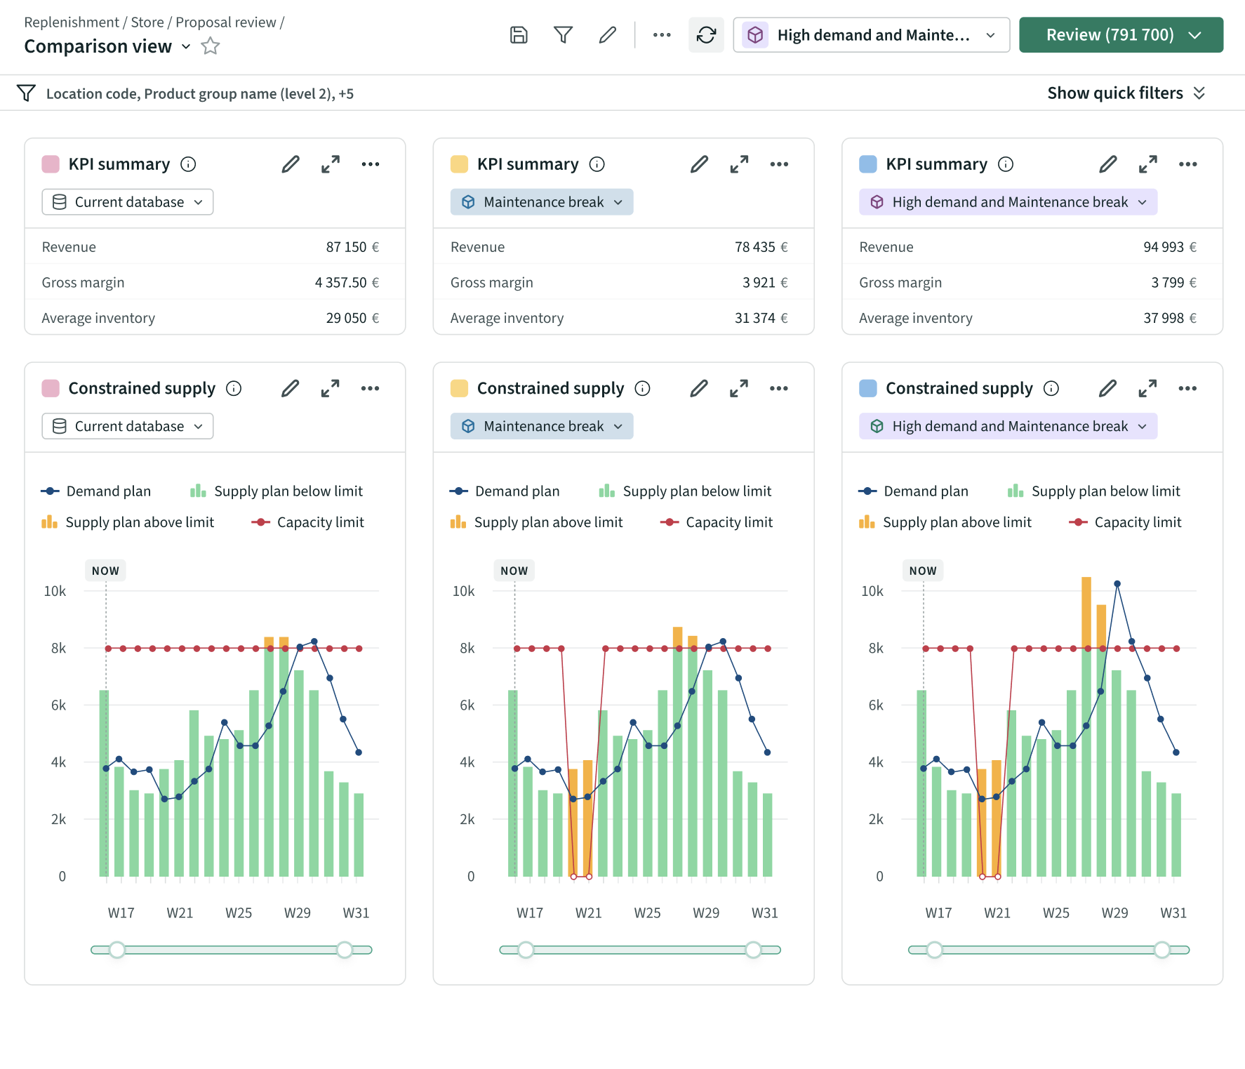
What-if analysis using scenarios
Scenarios
Create and compare different demand scenarios in one view
Commit the chosen scenario as the basis for planning
Example situations:
Risks with certain customers and their business
Good summer / bad summer alternatives
Potential big events
Changing consumer spending / confidence comparisons
Undestand the impact of possible demand scenarios and make informed decisions

Slide 33
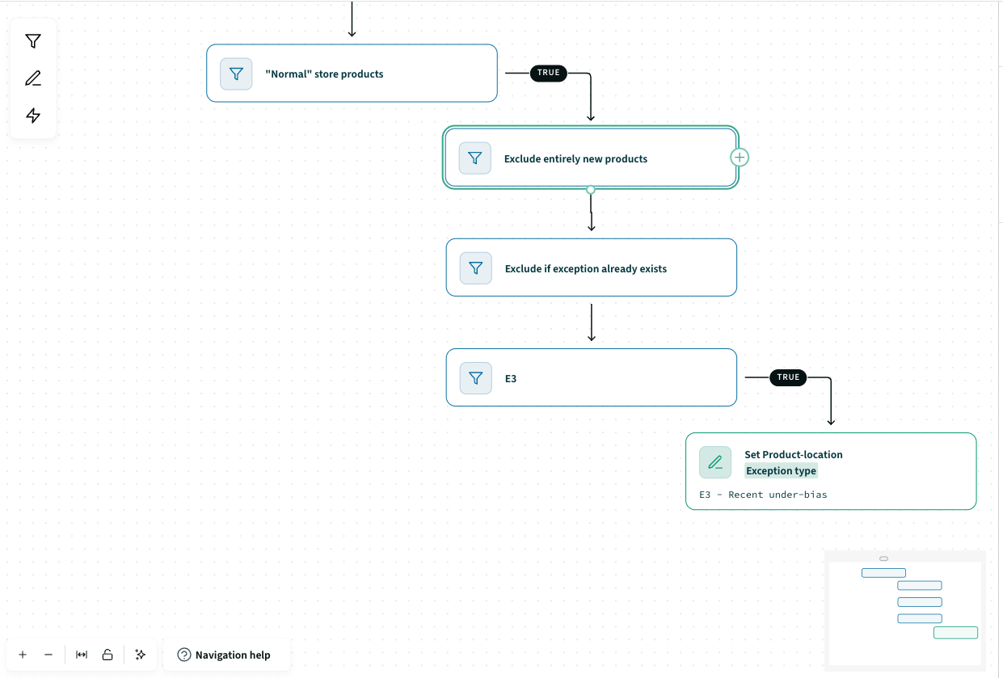
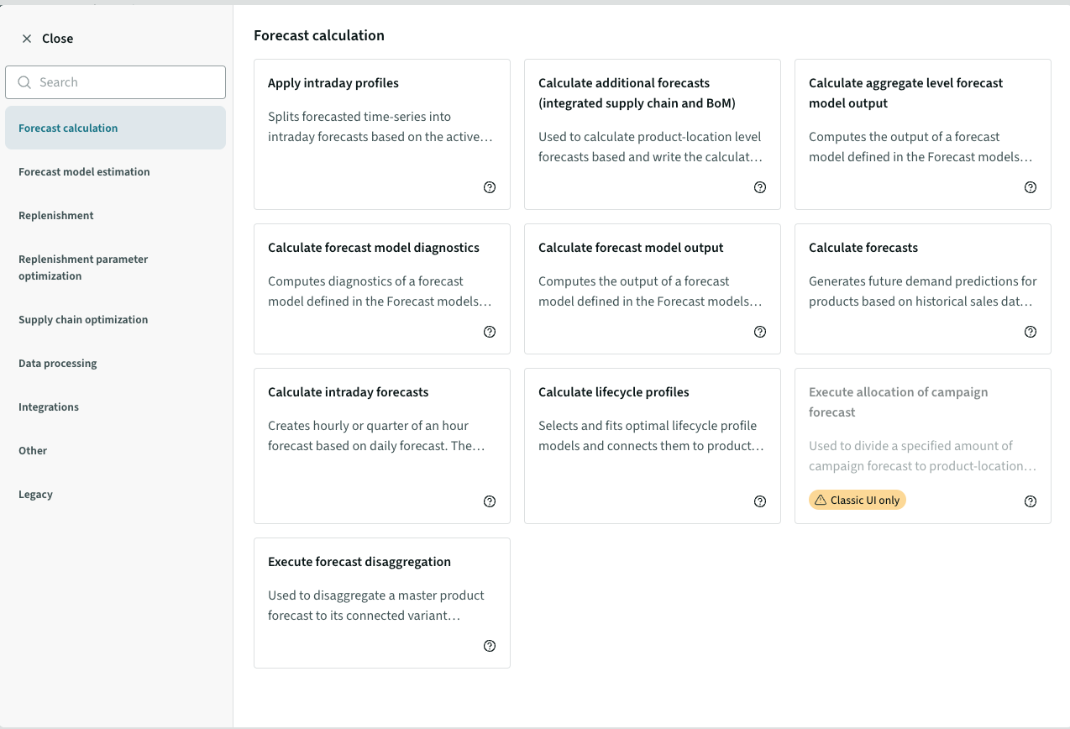
Enhancing process adaptability at business intersections Intuitive UI for quick configuration changes
Business Rules Engine
Business Rules
Actions in Business Rules
Visibilty to business logic i.e. workflows with filters and actions*
Ability to modify existing and create new workflows
Enables customer to become independent from vendor
Notes:
There are lots of acquisitions especially in F&B business -> more needs to changes

Slide 34
Proof points and examples
Deployed by many customers, recognized as a Leader by Coresight

Slide 35
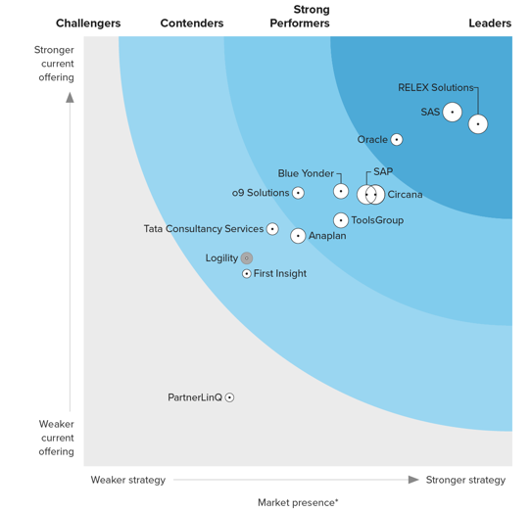
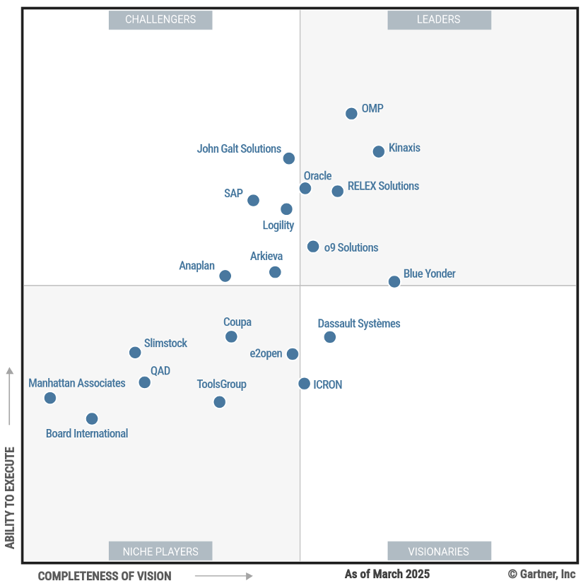
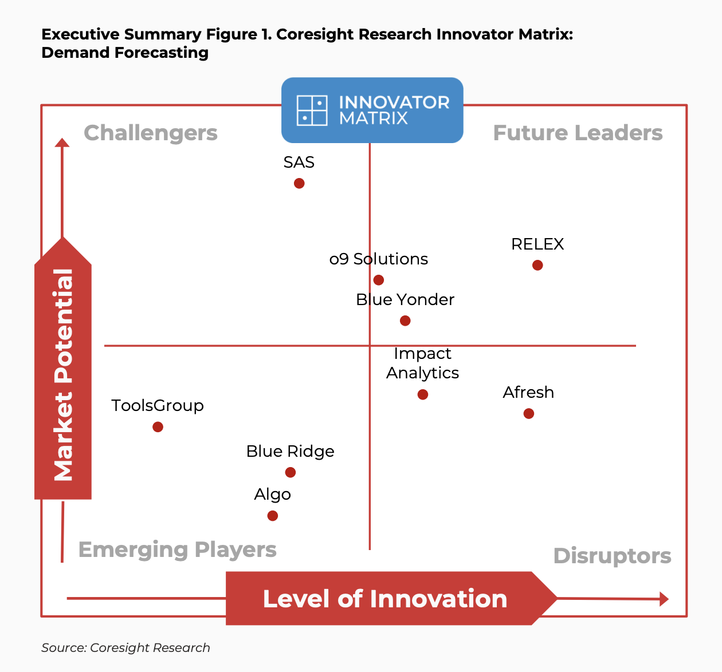
Recognized as an Industry Leader in recent Analyst Reports
Forrester Wave: Retail Planning Platforms – Q4 2023
Gartner: Supply Chain Planning Magic Quadrant – Q2 2025 The fastest mover from 2024 to 2025
Coresight: Demand Forecasting Innovator Matrix – Oct 2024
Notes:
Stefano

Slide 36
RELEX recognized as a leader in Coresight Demand Forecasting Innovator Matrix Report
Published in October 2024
Designed to help retailers and brands identify the top pre-IPO technology companies
RELEX rated as the Future Leader with the highest level of innovation and market potential
Leverage of AI and ML
Holistic approach to supply chain planning
Adaptability
Retail scale and benefits to manufacturers
Notes:
Coresight conducts a quantitative and qualitative analysis of companies’ level of innovation and market potential. Coresight’s selection of the top technology providers is based on their analysts’ expertise at the intersection of retail and technology, supported by key data sources.
Our ability to scale for retail benefits manufacturers who like to consumer PoS signals for VMI or other collaborative engagements

Slide 37
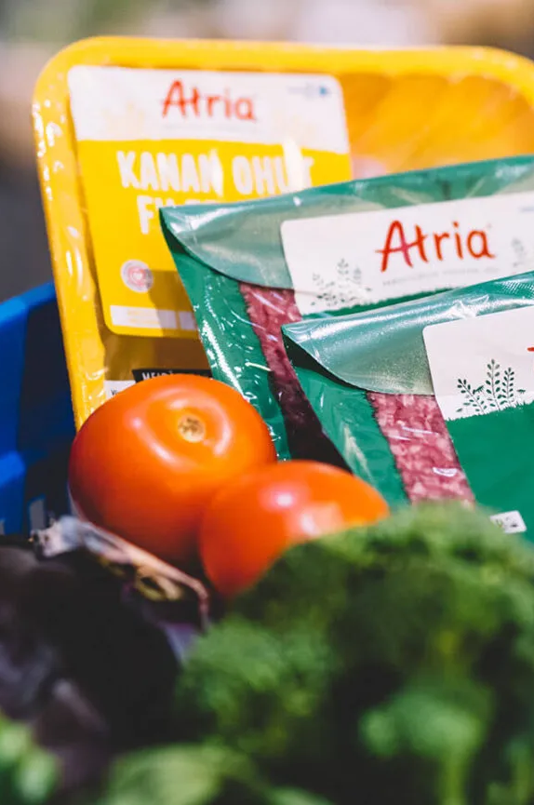
Atria: AI-Powered Demand Planning Accuracy in Consumer Goods Manufacturing
CUSTOMER CASE
Atria is a leading meat producer and food company in Northern Europe with 4,400 employees and EUR 1.5B turnover. Atria has been using RELEX’s demand planning solution for several years and introduced RELEX’s machine learning capabilities in 2020 to further improve their ability to manage the intricacies of meat products. They have also recently started a project with RELEX to improve forecast sharing and collaboration with one of their key retail customer, and in 2021 implemented RELEX for their business unit in Denmark.
Following the introduction of machine learning, we were extraordinarily impressed to see just how much further RELEX’s algorithms could improve our forecast accuracy and stability.”
Tapani Potka, SVP, Delivery Chain Management, Atria
98.1%
13%
More stable forecasts
Forecast accuracy on the weekly level, leveraging retail data
Reduction in manual forecast changes
even after large sales peaks during Atria's busiest seasons
Notes:
Case study: https://www.relexsolutions.com/resources/atria/
RELEX Plan customer

Slide 38
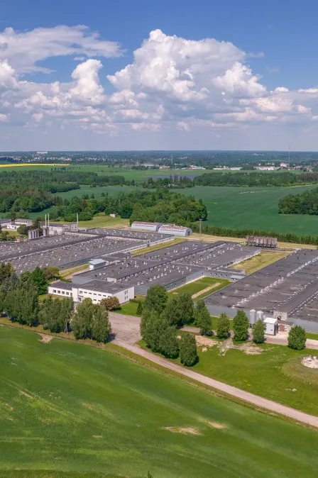
Maag Food: Advancing Demand Planning to Drive Future Success
CUSTOMER CASE
Maag Food, part of the MAAG Grupp, is a producer of chilled and frozen food products in Baltics. In 2023 they chose RELEX’s ML-based Demand Planning to replace their legacy planning solution with an intent to improve the forecasting quality and demand planning process.
Results after a few months of use:
Reduction of discount sales value of over 20%
Average supply reduced with close to 10% while delivery accuracy was maintained
Planners spend much less time on demand planning – 98% of the forecasts are untouched for several products
Sales is happy as campaign data is easy to maintain and assortment management is much more organised
We were impressed with the smooth implementation—it took just six months and stayed within budget. RELEX’s outstanding support and commitment to improving our KPIs have made a real difference.”
Martin Küüsmaa, Director of Business Development at Maag Food
Notes:
Before joining forces with RELEX, HKScan Baltics employed a legacy demand planning solution. The transition to RELEX was prompted by the need for greater forecasting accuracy, increased automation, and the reduction of internal waste and inventory, particularly stock close to its expiry date. Employing powerful AI and machine learning (ML) capabilities from RELEX coupled with years of experience, particularly in highly promotional-driven environments, and ability to balance short-term availability with long-term production stability and material needs, made them the ideal choice for Maag Grupp.
Due to acquisition and related IT changes needed a new solution for Demand Planning to maintain the process and improve the quality.
Chose RELEX ML based solution for Demand Planning in 2023 due to its hgh automation level, good support and proven track record on the market.
Results today (based on MAAG presentation in RELEX event in September 2024):
Cheap sales (discount sales to push out spoiling stock) from ~1.05% to ~0.85% of sales value. By a quick calculation this would mean reduction in cheap sales value of 23%.
Average supply went from ~5.7 to current ~5.2 – meaning roughly 9% reduction.
Delivery accuracy maintained on roughly the same level which maag is happy about. This should be investigated @Joosep Sõnajalg if we have a actually been able to improve on products/channels that matters most.
Planners spend less time on demand planning – 50…98% forecasts are untouched (this percentage varies between product groups)
Sales is happy as campaign data is easy to maintain and assortment management is much more organised
Case slide approved by MAAG Food on Oct 1, 2024

Slide 39

Significant improvements to demand forecasts with RELEX
CUSTOMER CASE
Results from a 2 month PoC with RELEX
European fresh food producer of salads, pizzas, and sandwiches, servicing large and medium grocery retailers
Challenges with the current Demand Planning system:
Low forecast accuracy of 83.6%
Inability to model all demand-impacting factors at the right granularity
High degree of manual changes
Proof of Concept with RELEX Demand Planning and Sensing:
DC orders used as input
Machine learning forecasting, accounting for promotions, weather, public holidays, events, cannibalization, and store coverage
92.4%
Weekly product-location
forecast accuracy
8.8pp
Improvement in forecast accuracy
90%
reduction of manual tasks
Notes:
Sodebo: salads, pizzas, boxes, sandwiches, etc
POC with the customer in 2024

Slide 40
What makes RELEX Demand Planning and Sensing Unique

Slide 41
RELEX Demand Planning and Sensing Uniqueness
Superior forecast accuracy at scale
Best practices with unique adaptability
One ML forecasting with demand sensing
Down to SKU/day granularity
Data integrity checks and cleansing
Special techniques for slow movers
Continuously developed templates based on entire customer base
Quick Time-to-Value with quality
UI based configurabillity of workflows
Adaptation to demand shifts by leveraging external signals
Market proven
Optimal planner productivity
Seamless integration with supply chain planning
150+ of happy customers including the largest retailers in the world
Dashboards with exceptions
Transparency to forecast components
GenAI based Rebot assistant
Less need for manual touches as algorithms adapt due to the use of ML
Forecast data automatically feeding master planning, S&OP/IBP and other planning processes
Same ‘truth’ of demand as a basis for all planning
Notes:
Superior forecast accuracy in scale
One platform with 100% ML forecasting and demand sensing
Down to SKU/day granularity
Automation in data integrity checks and cleansing
Special techniques for slow movers
Best practices with unique adaptability
Continuously developed and validated templates based on entire customer base
Quick Time-to-Value with quality
UI based configurabillity of workflows with self serve for business users (Business Rules as the key)
Automatically adapt to shifts in demand by leveraging external signals
Optimal planner productivity
Intuitive, modern dashboards with exception management
Transparency to forecast components
GenAI based Rebot assistant
Much less need for manual touches as algorithms adapt due to the use of ML
Seamless integration with supply chain planning
Forecast data automatically part of the supply chain processes
Same ‘truth’ of demand as a basis for all planning
Market proven
Hundreds of happy customers
Measured results

Slide 42
Thank you

Slide 43


Forecast hierarchies Ability to view and adjust forecasts at all levels
Changed
Affected
Not affected
Top Down
Middle Out
Bottom Up
✍️
Channel/customer
✍️
Channel
Product Group
Product-location
(default calculation node in RELEX)
✍️
Interactive aggregation and disaggregation enables flexible and fast edits, without losing the shape of the forecast across channels, products or time on lower levels.
Notes:
RELEX enables to update forecast at any level. For forecast updates at an aggregated level (not the native calculation level – sku-location-day) – RELEX will disaggregate down the demand based on each sku-location-day seasonality.
The key advantage is that the future seasonality will be reflected, contrary to using a rule generating seasonality based on past sales.
Also, this rule applies for time-bucket seasonality

